Slide 1
Chapter 6
Digital Filter Design

Slide 2
Main contents
Digital filter specifications
IIR DF design
FIR DF design

Slide 3
Objective - Determination of a realizable transfer function G(z) approximating a given frequency response specification is an important step in the development of a digital filter
If an IIR filter is desired, G(z) should be a stable real rational function
Digital filter design is the process of deriving the transfer function G(z)

Slide 4
§6.1 Digital Filter Specifications
Usually, either the magnitude and/or the phase (delay) response is specified for the design of digital filter for most applications
In some situations, the unit sample response or the step response may be specified
In most practical applications, the problem of interest is the development of a realizable approximation to a given magnitude response specification

Slide 5
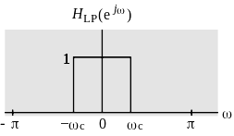
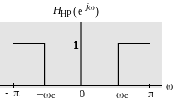
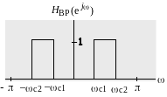
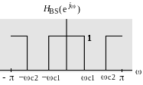
§6.1 Digital Filter Specifications
We discuss in this course only the magnitude approximation problem
There are four basic types of ideal filters with magnitude responses as shown below

Slide 6
§6.1 Digital Filter Specifications
As the impulse response corresponding to each of these ideal filters is noncausal and of infinite length, these filters are not realizable
In practice, the magnitude response specifications of a digital filter in the passband and in the stopband are given with some acceptable tolerances
In addition, a transition band is specified between the passband and stopband

Slide 7
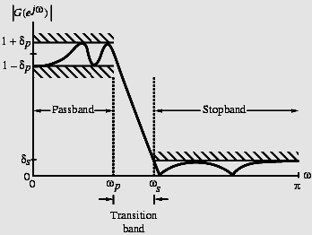
§6.1 Digital Filter Specifications
For example, the magnitude response |G(e^{jω})| of a digital lowpass filter may be given as indicated below

Slide 8
§6.1 Digital Filter Specifications
As indicated in the figure, in the passband, defined by 0≤ω≤ω_{p}, we require that |G(e^{jω})|≅1 with an error ±δ_{p}, i.e.,
1- δ_{p} ≤ |G(e^{jω})| ≤ 1+ δ_{p}, | ω| ≤ ω_{p}
In the stopband, defined by ω_{s} ≤ω≤π, we require that |G(e^{jω})|≅0 with an error δ_{s}
i.e., |G(e^{jω})| ≤ δ_{p}, ω_{s} ≤|ω|≤π

Slide 9
§6.1 Digital Filter Specifications
ω_{p} - passband edge frequency
ω_{s} - stopband edge frequency
δ_{p} - peak ripple value in the passband
δ_{s} - peak ripple value in the stopband
Since G(e^{jω}) is a periodic function of ω, and |G(e^{jω})| of a real-coefficient digital filter is an even function of ω
As a result, filter specifications are given only for the frequency range 0 ≤|ω|≤π

Slide 10
§6.1 Digital Filter Specifications
Specifications are often given in terms of loss function G(ω)=-20log₁₀ |G(e^{jω})| in dB
Peak passband ripple
α_{p}= -20log₁₀ (1- δ_{p} ) dB
Minimum stopband attenuation
α_{s}= -20log₁₀ (δ_{s} ) dB

Slide 11
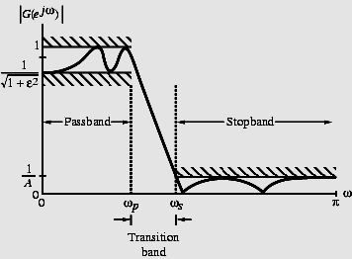
§6.1 Digital Filter Specifications
Magnitude specifications may alternately be given in a normalized form as indicated below

Slide 12
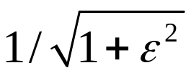
§6.1 Digital Filter Specifications
Here, the maximum value of the magnitude in the passband is assumed to be unity
- Maximum passband deviation, given by the minimum value of the magnitude in the passband
1/A - Maximum stopband magnitude

Slide 13
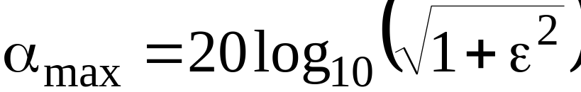
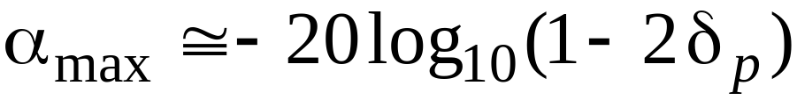
§6.1 Digital Filter Specifications
For the normalized specification, maximum value of the gain function or the minimum value of the loss function is 0 dB
Maximum passband attenuation
dB
For δ_{p}<<1, it can be shown that
dB

Slide 14
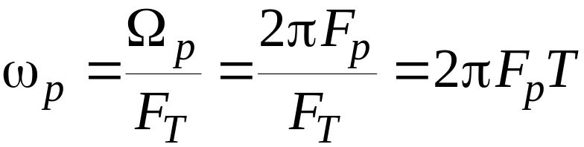

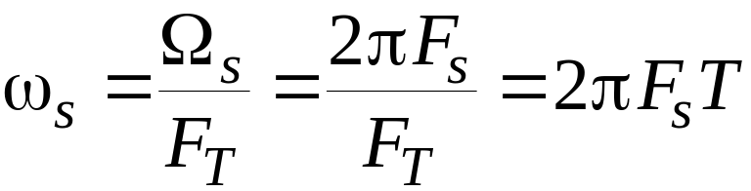
§6.1 Digital Filter Specifications
In practice, passband edge frequency F_{p}and stopband edge frequency F_{s} are specified in Hz
For digital filter design, normalized bandedge frequencies need to be computed from specifications in Hz using

Slide 15
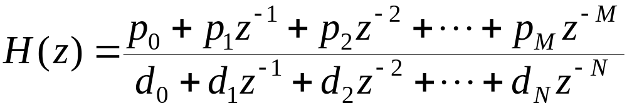
§6.2 Selection of Filter Type
The transfer function H(z) meeting the frequency response specifications should be a causal transfer function
For IIR digital filter design, the IIR transfer function is a real rational function of z⁻¹:
H(z) must be a stable transfer function and must be of lowest order N for reduced computational complexity

Slide 16
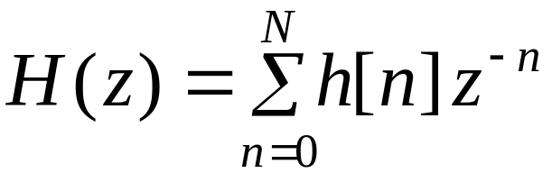
§6.2 Selection of Filter Type
For FIR digital filter design, the FIR transfer function is a polynomial in z⁻¹ with real coefficients:
For reduced computational complexity, degree N of H(z) must be as small as possible
If a linear phase is desired, the filter coefficients must satisfy the constraint:
h[n] = ± h[N-n]

Slide 17
§6.2 Selection of Filter Type
Advantages in using an FIR filter -
(1) Can be designed with exact linear phase,
(2) Filter structure always stable with quantized coefficients
Disadvantages in using an FIR filter - Order of an FIR filter, in most cases, is considerably higher than the order of an equivalent IIR filter meeting the same specifications, and FIR filter has thus higher computational complexity

Slide 18
§6.3 Digital Filter Design:
Basic Approaches
Most common approach to IIR filter design –
Convert the digital filter specifications into
an analog prototype lowpass filter specifications
(2) Determine the analog lowpass filter transfer function H_{a}(s)
(3) Transform H_{a}(s) into the desired digital transfer function G(z)

Slide 19
§6.3 Digital Filter Design:
Basic Approaches
This approach has been widely used for the following reasons:
(1) Analog approximation techniques are highly
advanced
(2) They usually yield closed-form solutions
(3) Extensive tables are available for analog
filter design
(4) Many applications require digital
simulation of analog systems

Slide 20
§6.3 Digital Filter Design:
Basic Approaches
An analog transfer function to be denoted as
H_{a}(s)= P_{a}(s) / D_{a}(s) =LT(h(t))
where the subscript “a” specifically indicates the analog domain
A digital transfer function derived from H_{a}(s) shall be denoted as
G(z)=P(z)/D(z)

Slide 21
§6.3 Digital Filter Design:
Basic Approaches
Basic idea behind the conversion of H_{a}(s) into G(z) is to apply a mapping from the s-domain to the z-domain so that essential properties of the analog frequency response are preserved
Thus mapping function should be such that
  Imaginary (jΩ ) axis in the s-plane be mapped onto the unit circle of the z-plane
  A stable analog transfer function be mapped into a stable digital transfer function

Slide 22
§6.3 Digital Filter Design:
Basic Approaches
FIR filter design is based on a direct approximation of the specified magnitude response, with the often added requirement that the phase be linear
The design of an FIR filter of order N may be accomplished by finding either the length-(N+1) impulse response samples {h[n]} or the (N+1) samples of its frequency response H(e^{jω})

Slide 23
§6.3 Digital Filter Design:
Basic Approaches
Three commonly used approaches to FIR filter design -
(1) Windowed Fourier series approach
(2) Frequency sampling approach
(3) Computer-based optimization methods

Slide 24
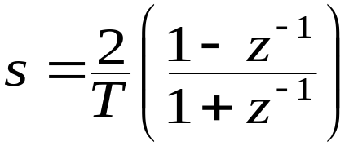
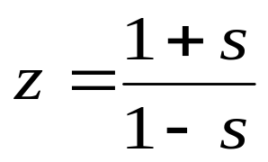
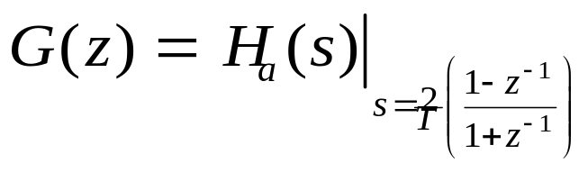
§6.4 IIR Digital Filter Design:
Bilinear Transformation Method
Bilinear transformation
Above transformation maps a single point in the s-plane to a unique point in the z-plane and vice-versa
Relation between G(z) and H_{a}(s) is then given by

Slide 25
§6.4 IIR Digital Filter Design: Bilinear Transformation Method
IIR Digital filter design consists of 3 steps:
(1) Develop the specifications of H_{a}(s) by
applying the inverse bilinear
transformation to specifications of G(z)
(2) Design H_{a}(s)
(3) Determine G(z) by applying bilinear
transformation to H_{a}(s)
the parameter T has no effect on G(z) and T = 2 is chosen for convenience

Slide 26
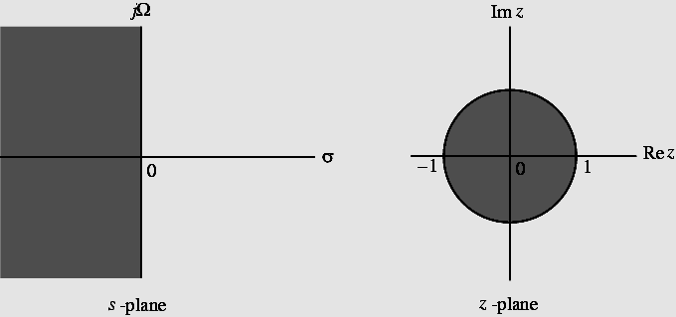
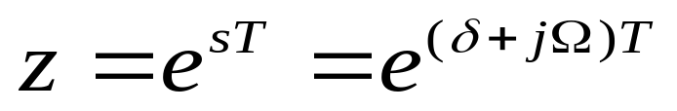
§6.4 IIR Digital Filter Design: Bilinear Transformation Method
Mapping of s-plane into the z-plane

Slide 27
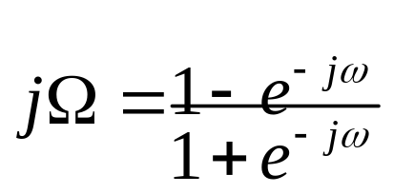
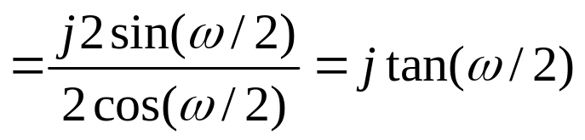
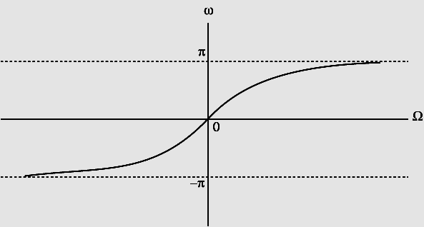
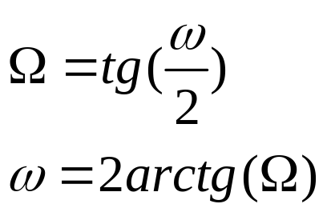
§6.4 IIR Digital Filter Design: Bilinear Transformation Method
For z=e^{jω} with T = 2 s=j Ω, we have
Mapping is highly nonlinear
Ω= - ∞ to Ω=0
z = -1 to z = 1
Ω=0 to Ω = ∞
z = 1 to z = - 1

Slide 28
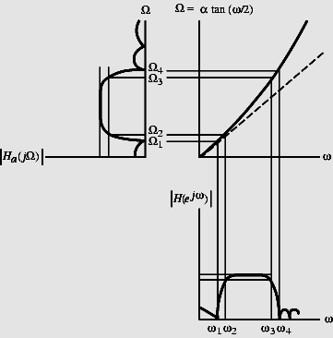
§6.4 IIR Digital Filter Design: Bilinear Transformation Method
Nonlinear mapping introduces a distortion in the frequency axis called frequency warping
Effect of warping shown right

Slide 29
§6.4 IIR Digital Filter Design: Bilinear Transformation Method
Steps in the IIR DF design of a digital filter -
(1) Prewarp (ω_{p}, ω_{s}) to find their analog
equivalents (Ω_{p}, Ω_{s})
(2) Design the analog filter H_{a}(s)
(3) Design the digital filter G(z) by applying
bilinear transformation to H_{a}(s)
Transformation can be used only to design digital filters with prescribed magnitude response with piecewise constant values
Transformation does not preserve phase response of analog filter

Slide 30
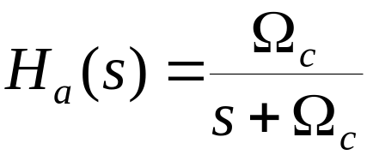
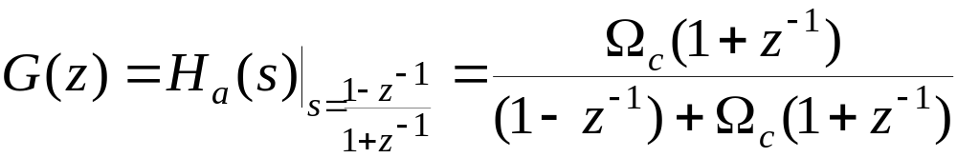
§6.4 IIR Digital Filter Design: Bilinear Transformation Method
Example - Consider
Applying bilinear transformation to the above we get the transfer function of a first-order digital lowpass Butterworth filter

Slide 31
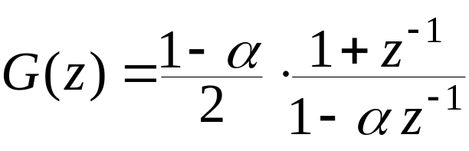
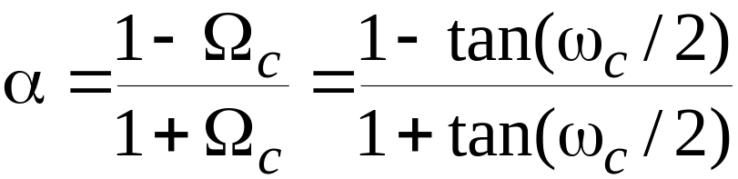
§6.4 IIR Digital Filter Design: Bilinear Transformation Method
Rearranging terms we get
where

Slide 32
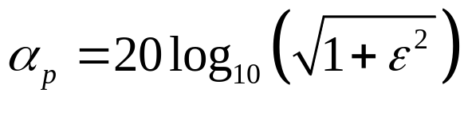
§6.4 IIR Digital Filter Design: Bilinear Transformation Method
Example - Design a lowpass Butterworth digital filter with ω_{p} =0.25π, ω_{s} = 0.55π,
α_{p}≤0.5 dB, and α_{s}≥15 dB
Thus ε²=0.1220185, A²=31.622777
If 20log |G(e^{j0})|=1 this implies
20log₁₀|G(e^{j0.25π})| ≥-0.5
20log₁₀|G(e^{j0.55π})| ≤-15
α_{s}= -20log₁₀ (1/A )

Slide 33
§6.4 IIR Digital Filter Design: Bilinear Transformation Method
Prewarping we get
Ω_{p}=tan(ω_{p}/2)=tan(0.25π/2)=0.4142136
Ω_{s} =tan(ω_{s}/2)=tan(0.55π/2)=1.1708496
The inverse transition ratio is
1/k = Ω_{s}/ Ω_{p} = 2.8266809
The inverse discrimination ratio is
1/k₁ = √(A²-1)/ε = 15.841979

Slide 34
§6.4 IIR Digital Filter Design: Bilinear Transformation Method
Thus
N=log₁₀(1/k₁)/ log₁₀(1/k) =2.6586997
Choose N = 3
To determine Ω_{c} we use
|H_{a}(jΩ_{p})|²= 1/[1+(Ω_{p}/ Ω_{c})^{2N}]=1/(1+ε²)

Slide 35
§6.4 IIR Digital Filter Design: Bilinear Transformation Method
We then get
Ω_{c}= 1.419915(Ω_{p})=0.588148
3rd-order lowpass Butterworth transfer function for Ω_{c}=1 is
H_{an}(s)=1/[(s+1)(s²+s+1)]
(this can be find from fixed table, see next slide )
Denormalizing to get Ω_{c}=0.588148 we arrive at
H_{a}(s)= H_{an}(s/0.588148)

Slide 36
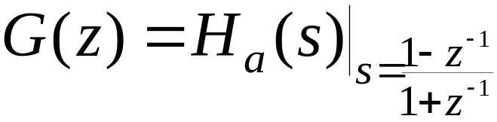
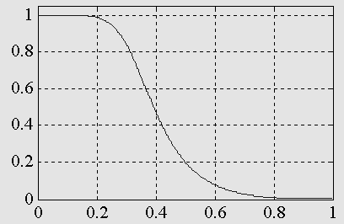
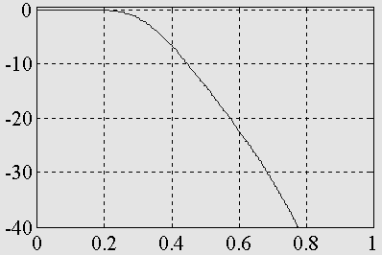
§6.4 IIR Digital Filter Design: Bilinear Transformation Method
Applying bilinear transformation to H_{a}(s) we get the desired digital transfer function
Magnitude and gain responses of G(z) shown below:

Slide 37
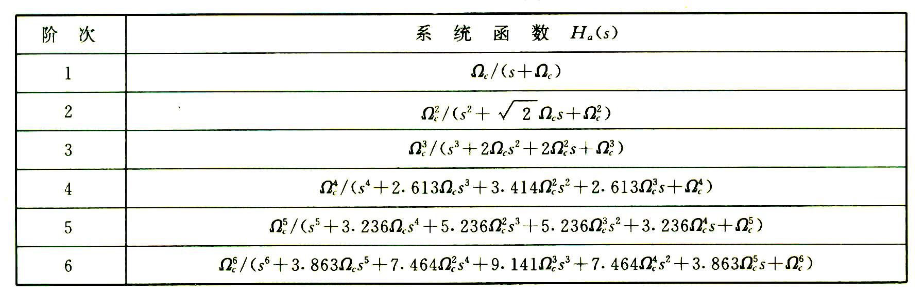
order
Transfor function

Slide 38
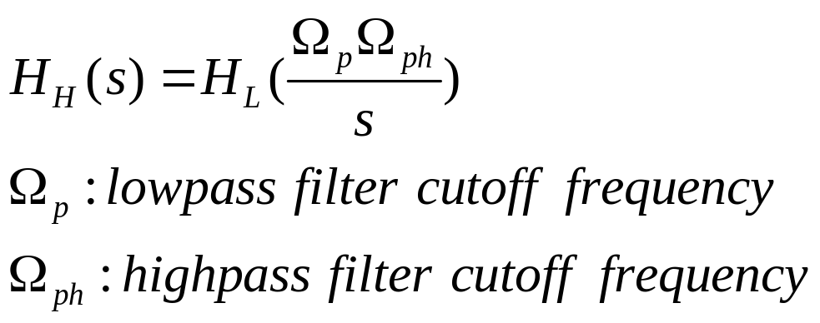
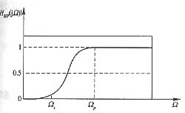
Other types of analog filters design
Other types of analog filters design from analog lowpass filter:
From lowpass to highpass filter:

Slide 39
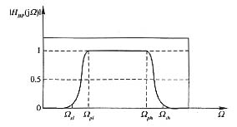
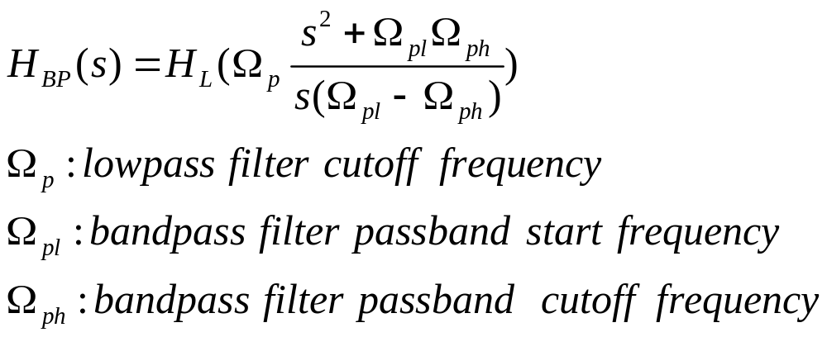
From lowpass to bandpass

Slide 40
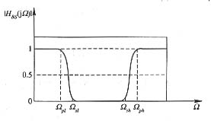
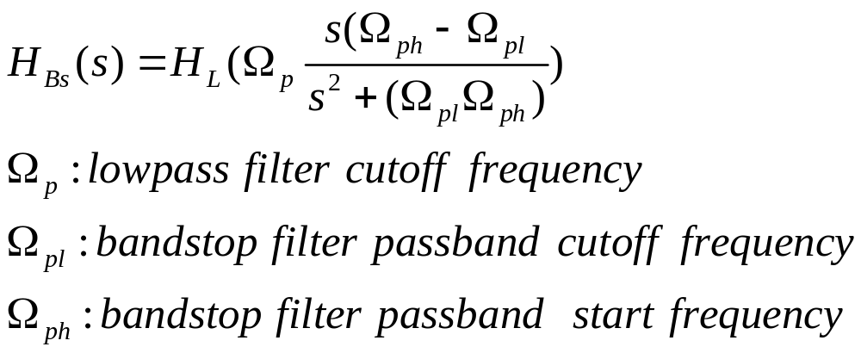
From lowpass to bandstop

Slide 41
§6.5 IIR Highpass, Bandpass, and Bandstop Digital Filter Design
(1) Prewarp digital frequency specifications of desired
digital filter G_{D}(z) to arrive at frequency
specifications of analog filter H_{D}(s) of same type
(2) Convert frequency specifications of H_{D}(s) into that
of prototype analog lowpass filter H_{LP}(s)
(3) Design analog lowpass filter H_{LP}(s)
(4) Convert HLP(s) into HD(s) using inverse
frequency transformation used in Step 2
(5) Design desired digital filter GD(z) by applying
bilinear transformation to HLP(s)

Slide 42
§6.5 IIR Highpass, Bandpass, and Bandstop Digital Filter Design
Design of a Type 1 Chebyshev IIR digital highpass filter
Specifications: F_{p}=700Hz, F_{s} = 500Hz,
α_{p}=1 dB, α_{s}=32dB, F_{T}=2 kHz
Normalized angular bandedge frequencies
ω_{p} =2πF_{p}/ F_{T}= 2π×700/2000=0.7π
ω_{s} = 2πF_{s}/ F_{T}= 2π×500/2000=0.5π

Slide 43
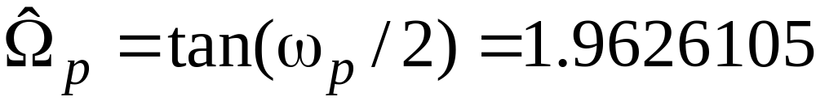
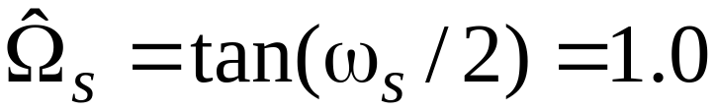
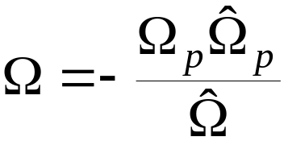
§6.5.1 IIR Highpass Digital Filter Design
Prewarping these frequencies we get
For the prototype analog lowpass filter choose
Ω_{p} = 1
Using we get Ω_{s} = 1.962105
Analog lowpass filter specifications: Ω_{p} = 1 ,
Ω_{s} = 1.926105 , α_{p}=1 dB, α_{s}=32 dB

Slide 44
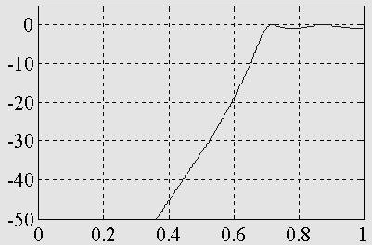
§6.5.1 IIR Highpass Digital Filter Design
MATLAB code fragments used for the design
[N, Wn] = cheb1ord(1, 1.9626105, 1, 32, ’s’)
[B, A] = cheby1(N, 1, Wn, ’s’);
[BT, AT] = lp2hp(B, A, 1.9626105);
[num, den] = bilinear(BT, AT, 0.5);

Slide 45
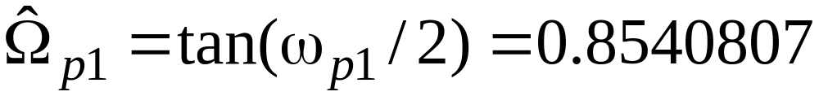
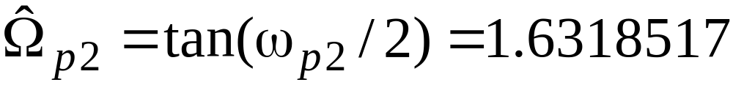
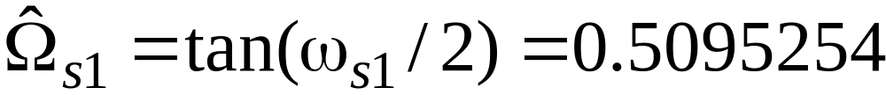
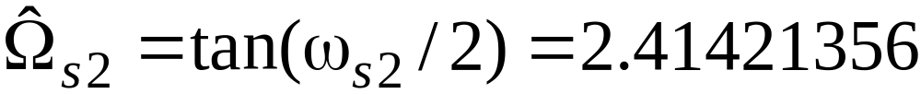
§6.5.2 IIR Bandpass Digital Filter Design
(self-learning)
Design of a Butterworth IIR digital bandpass filter
Specifications: ω_{p1}=0.45π , ω_{p1}=0.65π ,
ω_{s1}=0.3π, ω_{s2}=0.75π, α_{p}=1 dB, α_{s}=40 dB
Prewarping we get

Slide 46
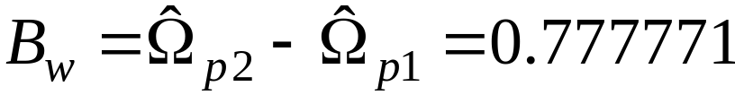
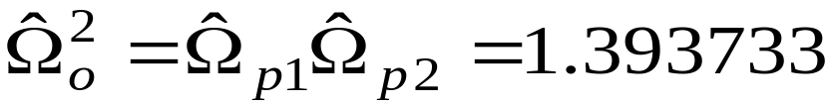

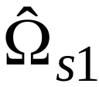


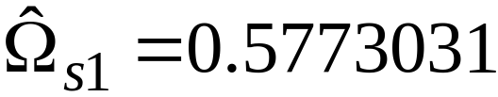
§6.5.2 IIR Bandpass Digital Filter Design
(self-learning)
Width of passband
We therefore modify so that and exhibit geometric symmetry with respect to
We set
For the prototype analog lowpass filter we choose Ω_{p} = 1

Slide 47


§6.5.2 IIR Bandpass Digital Filter Design
(self-learning)
Using we get
Specifications of prototype analog Butterworth lowpass filter: Ω_{p} = 1, Ω_{s}=2.3617627, α_{p}=1 dB, α_{s}=40 dB

Slide 48

§6.5.2 IIR Bandpass Digital Filter Design
(self-learning)
MATLAB code fragments used for the design
[N, Wn] = buttord(1, 2.3617627, 1, 40, ’s’)
[B, A] = butter(N, Wn, ’s’);
[BT, AT] = lp2bp(B, A, 1.1805647, 0.777771);
[num, den] = bilinear(BT, AT, 0.5);

Slide 49






§6.5.3 IIR Bandstop Digital Filter Design
(self-learning)
Design of an elliptic IIR digital bandstop filter
Specifications: ω_{s1}=0.45π, ω_{s2}=0.65π , ω_{p1}=0.3π, ω_{p2}=0.75π, α_{p}=1 dB, α_{s}=40 dB
Prewarping we get
Width of stopband

Slide 50



§6.5.3 IIR Bandstop Digital Filter Design
(self-learning)
We therefore modify so that and exhibit geometric symmetry with respect to
We set
For the prototype analog lowpass filter we choose Ω_{s}= 1
Using we get

Slide 51

§6.5.3 IIR Bandstop Digital Filter Design
(self-learning)
MATLAB code fragments used for the design
[N, Wn] = ellipord(0.4234126, 1, 1, 40, ’s’);
[B, A] = ellip(N, 1, 40, Wn, ’s’);
[BT, AT] = lp2bs(B, A, 1.1805647, 0.777771);
[num, den] = bilinear(BT, AT, 0.5);

Slide 52


§6.6 FIR DF Design
-----window method
Suppose to design a lowpass filter
start with a ideal lowpass response as follows:
The frequency is normalized: T=1

Slide 53


§6.6 FIR DF Design
-----window method
As frequency response is known, the corresponding impulse is given by:

Slide 54



§6.6 FIR DF Design
-----window method
is symmetrical and the filter is a linear phase
response
The filter is not casual and can not be implemented
actually.
The filter is not an FIR DF
Solution:
truncate the ideal impulse response by setting
To appropriate the ideal filter.
Truncate method is using window funciton, such as
rectangular window:

Slide 55



§6.6 FIR DF Design
-----window method
problems:
Overshoots and ripples in frequency domain
Solution :
Select a suitable window function w(n).
13 coefficients
25coefficients
An infinite number coefficients

Slide 56
§6.6.1 Some Common Window Functions
Rectangular : w(n)=1 -M≤n ≤M
Hanning:
W[n[=0.5+0.5cos[2πn/(2M+1)], -M≤n ≤M
Hamming:
W[n[=0.54+0.46cos[2πn/(2M+1)], -M≤n ≤M
Blackman:
W[n[=0.42+0.5cos[2πn/(2M+1)]
+0.08cos[4πn/(2M+1)]

Slide 57
§6.6.1 Some Common Window Functions
Plots of magnitudes of the DTFTs of these windows for M = 25 are shown below
Rectangular window
Hanning window
0
0
-20
-20
Gain, dB
Gain, dB
-40
-40
-60
-60
-80
-80
-100
-100
0
0.2
0.4
0.6
0.8
1
0
0.2
0.4
0.6
0.8
1
ω
/
π
ω
/
π
Hamming window
Blackman window
0
0
-20
-20
-40
-40
Gain, dB
Gain, dB
-60
-60
-80
-80
-100
0
0.2
0.4
0.6
0.8
1
-100
0
0.2
0.4
0.6
0.8
1
ω
/
π
ω
/
π

Slide 58
§6.6.1 Some Common Window Functions
Magnitude spectrum of each window characterized by a main lobe centered at ω = 0 followed by a series of sidelobes with decreasing amplitudes
Parameters predicting the performance of a window in filter design are:
----Main lobe width
----Relative sidelobe level

Slide 59
§6.6.1 Some Common Window Functions
Main lobe width Δ_{ML}-
given by the distance between zero crossings on both sides of main lobe
Relative sidelobe level A_{sl} –
given by the difference in dB between amplitudes of largest sidelobe and main lobe

Slide 60

§6.6.1 Some Common Window Functions
Thus, passband and stopband ripples are the same

Slide 61
§6.6.1 Some Common Window Functions
Distance between the locations of the maximum passband deviation and minimum stopband value ≅Δ_{ML}
Width of transition band
Δω = ω_{s} − ω_{p} < Δ_{ML}

Slide 62
§6.6.1 Some Common Window Functions
To ensure a fast transition from passband to stopband, window should have a very small main lobe width
To reduce the passband and stopband ripple δ, the area under the sidelobes should be very small
Unfortunately, these two requirements are contradictory

Slide 63
§6.6.1 Some Common Window Functions
In the case of rectangular, Hann, Hamming, and Blackman windows, the value of ripple does not depend on filter length or cutoff frequency ω_{c} , and is essentially constant
In addition, width of transition band is
Δω ≈ c / Μ
where c is a constant for most practical purposes

Slide 64
§6.6.1 Some Common Window Functions
Rectangular window - Δ_{ML}=4π/(2M+1)
A_{sl}=13.3 dB, α_{s}=20.9 dB, Δ_{ω}=0.92π/M
Hann window - Δ_{ML}=8π/(2M+1)
A_{sl}=31.5 dB, α_{s}=43.9 dB, Δ_{ω}=3.11π/M
Hamming window - Δ_{ML}=8π/(2M+1)
A_{sl}=42.7 dB, α_{s}=54.5 dB, Δ_{ω}=3.32π/M,
Blackman window - Δ_{ML}=12π/(2M+1)
A_{sl}=58.1 dB, α_{s}=75.3 dB, Δ_{ω}=5.56π/M

Slide 65
§6.7 FIR Filter Design Example
Filter Design Steps -
(1) Set
ω_{c} =(ω_{p} + ω_{s} )/2
(2) Choose window based on specified
(3) Estimate M using
Δ_{ω}≈ c / M

Slide 66
§6.7 FIR Filter Design Example
Lowpass filter of length 51 and ω_{c}=π/2
Lowpass Filter Designed Using Hann window
Lowpass Filter Designed Using Hamming window
0
0
Gain, dB
-50
-50
Gain, dB
-100
-100
0
0.2
0.4
0.6
0.8
1
0
0.2
0.4
0.6
0.8
1
ω
/
π
ω
/
π
Lowpass Filter Designed Using Blackman window
0
Gain, dB
-50
-100
0
0.2
0.4
0.6
0.8
1
ω
/
π

Slide 67
§6.7 FIR Filter Design Example
An increase in the main lobe width is associated with an increase in the width of the transition band
A decrease in the sidelobe amplitude results in an increase in the stopband attenuation

